Slide 1
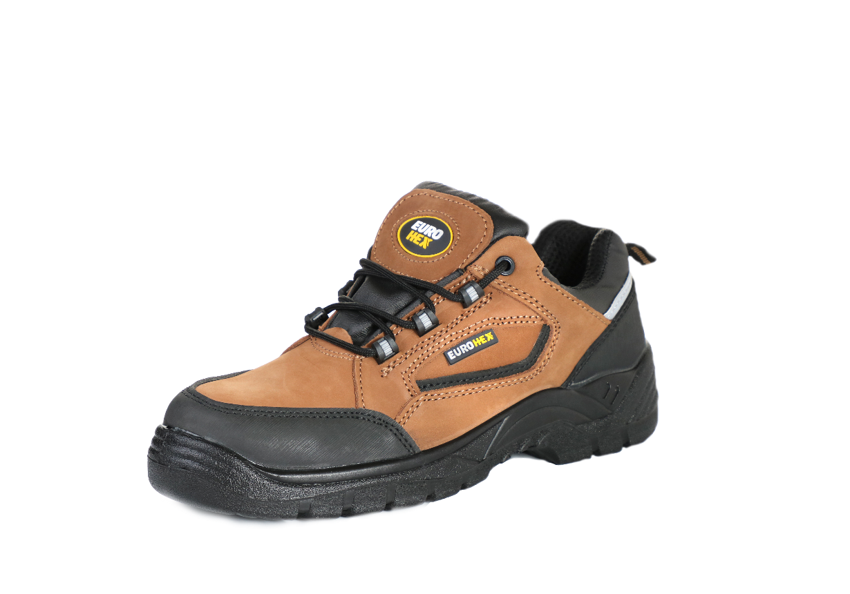

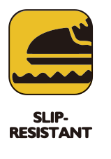








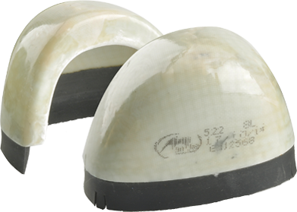

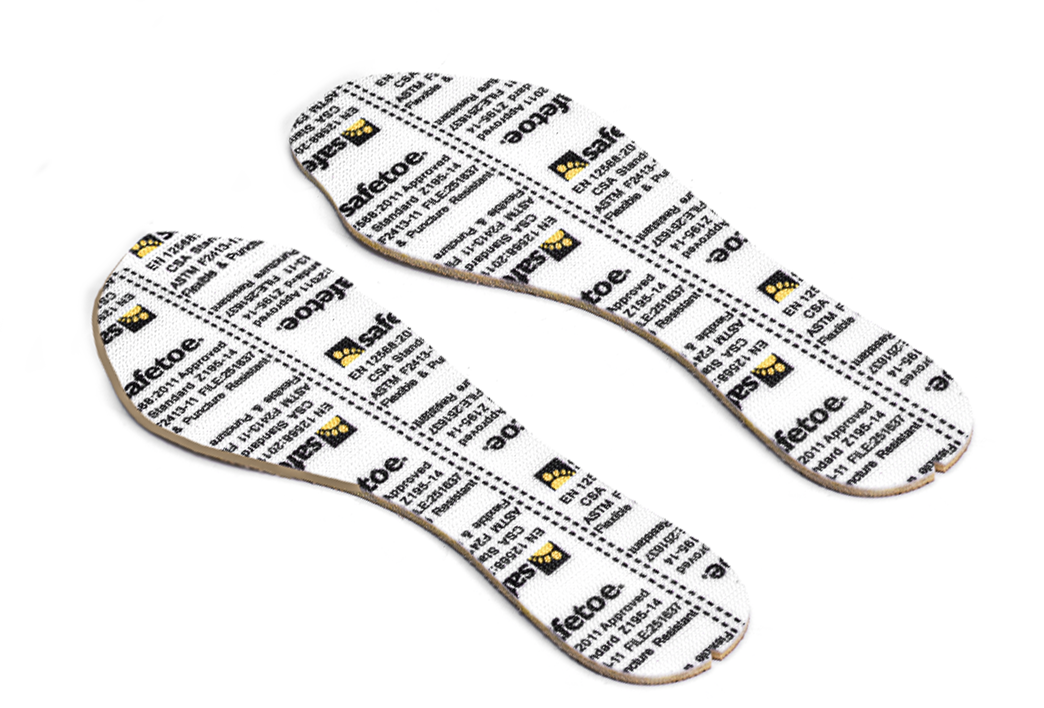


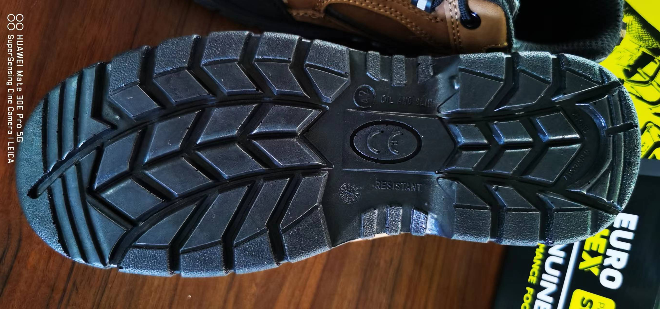

L-7342 S3 SRC
Composite
Memory Foam Insole
Superior Safety Shoes (Metal Free)
Heavy Duty Low Cut Safety Shoes Work is made with Brown Cow Nubuck Leather and PU/Rubber Outsole. It is approved by Europe SGS Lab with CE S3 category, and USA ASTM.
Upper : Brown Cow Nubuck Leather
Lining : Breathable Sandwich Air Mesh
Insole : Comfortable EVA Coated Mesh
Outsole : PU/PU Injection
Toecap : Composite Toecap
Penetration : Kevlar Midsole Plate
Size : EU #39-46
CE EN ISO 20345:2011 S3 SRC & ASTM F2413-18 M I/75 C/75 PR
Composite Toe Cap Protection • AN1-EN12568
It is made with light weight fiber-glass material, which can reach 200 joules from falling or rolling objects. It is stronger and more light than steel toecap.
EXTRA WIDE
Kevlar Plate Protection • AN1-EN12568
Kevlar midsole plate, is zero-penetration resistant. It can resist 1100 newtons nail puncture from sharp objects. It is stronger and more flexible than steel plate.
Brown Cow Nubuck Leather Upper • CE EN ISO 20345:2011
High quality brown cow nubuck leather with thickness 1.6-1.8mm. It is treated with breathable technology to keep feet from dry during walking all days. Tear strength is required 10% higher than Europe test requirement, to reach longer lifespan.
Heavy Duty PU/PU Outsole • CE EN ISO 20345:2011
The outsole is made with PU/PU dual density material. The midsole is 45±5 degree hardness PU, which is soft and shock absorption.The outsole is 65±5 degree hardness PU, which is tough and abrasion resistant. The outsole can pass SRC slip-resistant test.

Slide 2
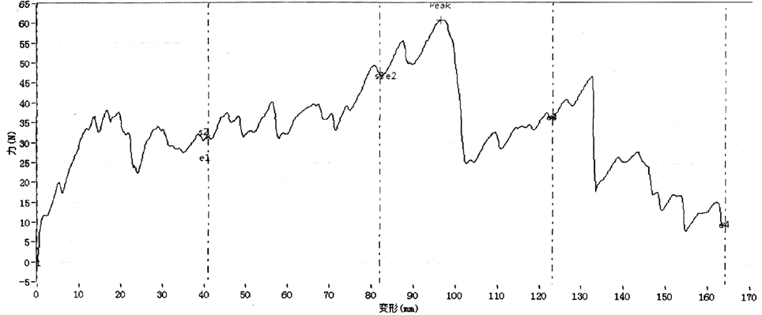
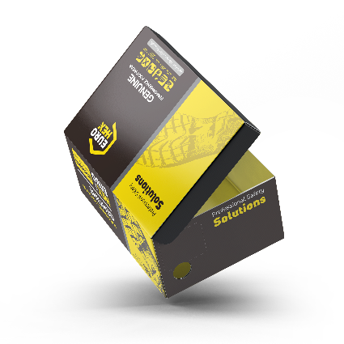
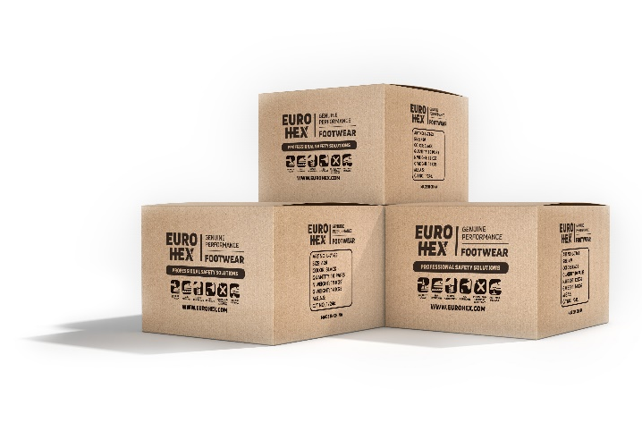
Sole Bonding Strength Test
EN ISO 20344:2011, 5.2 (Between Upper & Sole)
Average Test Result 5.8±5 (N/mm)
Leather Tear Strength ≥ | 120.0 Newtons
Leather Tensile Properties ≥ | 15.0 N/mm²
Lining Tear Strength ≥ | 15.0 N/mm
Bonding Strength ≥ | 4.0 N/mm
Upper, Lining & Bonding Strength Test Result
√ Protection With Slip Resistant (SRC) Result
Test Requirement : SRA (Eurotile 2+Nal S) Forward Heel Slip ≥0.28 & Forward Flat Slip: ≥0.32 SRB (Steel Floor+Glycerine) Forward Heel Slip ≥0.13 & Forward Flat Slip: ≥0.18
Standards : EN ISO 20344:2011(5.11) , SRC Means both SRA & SRB requirements are fulfilled.
√ Protection Against Heat Risk 300℃ Result
Test Requirement : The Outsole Did Not Melt & Did Not Develop Any Cracks When Bent Aound Mandrel
Standards : EN ISO 20344:2011(8.7). 300℃ HRO=Heat Resistant
√ Protection Resistant to Fuel Oil Result
Test Requirement : Change in Volume and Change in Hardness (Outsole) is No More Than +12%(*)
Standards : EN ISO 20344:2011(8.6.1)
SAFETOE Standard Package Instruction (Average 42# for Reference)
Shoes Weight : 1.2-1.3 KGS / Pair | Carton Weight : 13-14 KGS / Carton
1 Pair / Color Box , Dimensions : 32×21×12CM | 10 Pair / Carton , Dimensions : 62×43×33CM
PASS
PASS
PASS
User Instructions:
1.) RECOMMENDED TO USE : Construction, Logistics, Mechanics, Glasses Installation, Workshop, Farming, Garden, Oil & Gas, Chemical Factory etc.
2.) LIMITATION TO USE: It is very important that footwear selected must be suitable for the right workplaces. The protection against risks or hazards which are not mentioned in this document is not warranted.
3.) FITTING & SIZE: All footwear are marked with standard size on tongue label. Some are with different size comparation, such as EU size, UK size, US size etc. Please wear footwear in a suitable size.
Footwear which are too loose or too tight may not provide optimum level of protection.
4.) STORAGE: Keep the footwear in its original packaging, under ordinary temperature, non-humidity conditions and in clean, covered and ventilated premises.
5.) CLEANING: Clean footwear regularly by high quality cleaning treatments recommended as suitable for the purpose. Don't use caustic or corrosive cleaning agents.

